Slide 1

Chapter 11
Binary Search Trees

Slide 2
Chapter Scope
Binary search tree processing
Using BSTs to solve problems
BST implementations
Strategies for balancing BSTs

Slide 3
Binary Search Trees
A search tree is a tree whose elements are organized to facilitate finding a particular element when needed
A binary search tree is a binary tree that, for each node n
the left subtree of n contains elements less than the element stored in n
the right subtree of n contains elements greater than or equal to the element stored in n

Slide 4
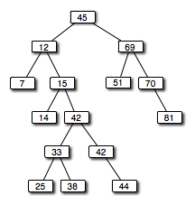
Binary Search Trees

Slide 5
Binary Search Trees
To determine if a particular value exists in a tree
start at the root
compare target to element at current node
move left from current node if target is less than element in the current node
move right from current node if target is greater than element in the current node
We eventually find the target or encounter the end of a path (target is not found)

Slide 6
Binary Search Trees
The particular shape of a binary search tree depends on the order in which the elements are added
The shape may also be dependant on any additional processing performed on the tree to reshape it
Binary search trees can hold any type of data, so long as we have a way to determine relative ordering
Objects implementing the Comparable interface provide such capability

Slide 7
Binary Search Trees
Process of adding an element is similar to finding an element
New elements are added as leaf nodes
Start at the root, follow path dictated by existing elements until you find no child in the desired direction
Then add the new element

Slide 8
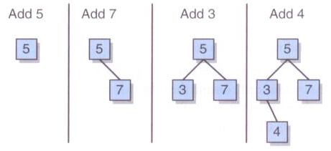
Binary Search Trees
Adding elements to a BST:

Slide 9
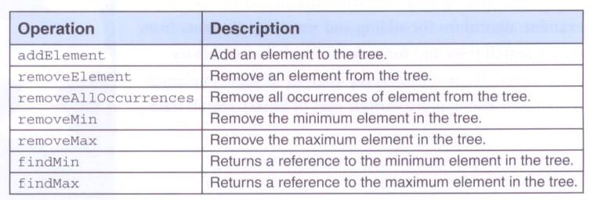
Binary Search Trees
BST operations:

Slide 10
package jsjf;
/**
* BinarySearchTreeADT defines the interface to a binary search tree.
*
* @author Lewis and Chase
* @version 4.0
*/
public interface BinarySearchTreeADT<T> extends BinaryTreeADT<T>
{
/**
* Adds the specified element to the proper location in this tree.
*
* @param element the element to be added to this tree
*/
public void addElement(T element);
/**
* Removes and returns the specified element from this tree.
*
* @param targetElement the element to be removed from the tree
* @return the element to be removed from the tree
*/
public T removeElement(T targetElement);

Slide 11
/**
* Removes all occurences of the specified element from this tree.
*
* @param targetElement the element to be removed from the tree
*/
public void removeAllOccurrences(T targetElement);
/**
* Removes and returns the smallest element from this tree.
*
* @return the smallest element from the tree.
*/
public T removeMin();
/**
* Removes and returns the largest element from this tree.
*
* @return the largest element from the tree
*/
public T removeMax();

Slide 12
/**
* Returns the smallest element in this tree without removing it.
*
* @return the smallest element in the tree
*/
public T findMin();
/**
* Returns the largest element in this tree without removing it.
*
* @return the largest element in the tree
*/
public T findMax();
}

Slide 13
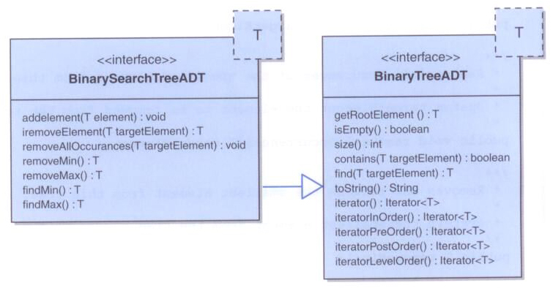
Binary Search Trees

Slide 14
package jsjf;
import jsjf.exceptions.*;
import jsjf.*;
/**
* LinkedBinarySearchTree implements the BinarySearchTreeADT interface
* with links.
*
* @author Lewis and Chase
* @version 4.0
*/
public class LinkedBinarySearchTree<T> extends LinkedBinaryTree<T>
implements BinarySearchTreeADT<T>
{
/**
* Creates an empty binary search tree.
*/
public LinkedBinarySearchTree()
{
super();
}

Slide 15
/**
* Creates a binary search with the specified element as its root.
*
* @param element the element that will be the root of the new binary
* search tree
*/
public LinkedBinarySearchTree(T element)
{
super(element);
if (!(element instanceof Comparable))
throw new NonComparableElementException("LinkedBinarySearchTree");
}

Slide 16
/**
* Adds the specified object to the binary search tree in the
* appropriate position according to its natural order. Note that
* equal elements are added to the right.
*
* @param element the element to be added to the binary search tree
*/
public void addElement(T element)
{
if (!(element instanceof Comparable))
throw new NonComparableElementException("LinkedBinarySearchTree");
Comparable<T> comparableElement = (Comparable<T>)element;
if (isEmpty())
root = new BinaryTreeNode<T>(element);
else
{
if (comparableElement.compareTo(root.getElement()) < 0)
{
if (root.getLeft() == null)
this.getRootNode().setLeft(new BinaryTreeNode<T>(element));
else
addElement(element, root.getLeft());
}

Slide 17
else
{
if (root.getRight() == null)
this.getRootNode().setRight(new BinaryTreeNode<T>(element));
else
addElement(element, root.getRight());
}
}
modCount++;
}

Slide 18
/**
* Adds the specified object to the binary search tree in the
* appropriate position according to its natural order. Note that
* equal elements are added to the right.
*
* @param element the element to be added to the binary search tree
*/
private void addElement(T element, BinaryTreeNode<T> node)
{
Comparable<T> comparableElement = (Comparable<T>)element;
if (comparableElement.compareTo(node.getElement()) < 0)
{
if (node.getLeft() == null)
node.setLeft(new BinaryTreeNode<T>(element));
else
addElement(element, node.getLeft());
}
else
{
if (node.getRight() == null)
node.setRight(new BinaryTreeNode<T>(element));
else
addElement(element, node.getRight());
}
}

Slide 19
BST Element Removal
Removing a target in a BST is not as simple as that for linear data structures
After removing the element, the resulting tree must still be valid
Three distinct situations must be considered when removing an element
The node to remove is a leaf
The node to remove has one child
The node to remove has two children

Slide 20
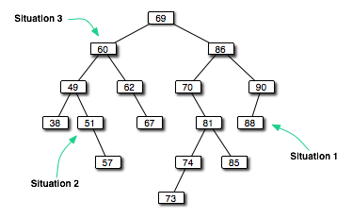
BST Element Removal

Slide 21
BST Element Removal
Dealing with the situations
Node is a leaf: it can simply be deleted
Node has one child: the deleted node is replaced by the child
Node has two children: an appropriate node is found lower in the tree and used to replace the node
Good choice: inorder successor (node that would follow the removed node in an inorder traversal)
The inorder successor is guaranteed not to have a left child
Thus, removing the inorder successor to replace the deleted node will result in one of the first two situations (it’s a leaf or has one child)

Slide 22
/**
* Removes the first element that matches the specified target
* element from the binary search tree and returns a reference to
* it. Throws a ElementNotFoundException if the specified target
* element is not found in the binary search tree.
*
* @param targetElement the element being sought in the binary search tree
* @throws ElementNotFoundException if the target element is not found
*/
public T removeElement(T targetElement)
throws ElementNotFoundException
{
T result = null;
if (isEmpty())
throw new ElementNotFoundException("LinkedBinarySearchTree");
else
{
BinaryTreeNode<T> parent = null;
if (((Comparable<T>)targetElement).equals(root.element))
{
result = root.element;
BinaryTreeNode<T> temp = replacement(root);
if (temp == null)
root = null;

Slide 23
else
{
root.element = temp.element;
root.setRight(temp.right);
root.setLeft(temp.left);
}
modCount--;
}
else
{
parent = root;
if (((Comparable)targetElement).compareTo(root.element) < 0)
result = removeElement(targetElement, root.getLeft(), parent);
else
result = removeElement(targetElement, root.getRight(), parent);
}
}
return result;
}

Slide 24
/**
* Removes the first element that matches the specified target
* element from the binary search tree and returns a reference to
* it. Throws a ElementNotFoundException if the specified target
* element is not found in the binary search tree.
*
* @param targetElement the element being sought in the binary search tree
* @param node the node from which to search
* @param parent the parent of the node from which to search
* @throws ElementNotFoundException if the target element is not found
*/
private T removeElement(T targetElement, BinaryTreeNode<T> node, BinaryTreeNode<T> parent)
throws ElementNotFoundException
{
T result = null;
if (node == null)
throw new ElementNotFoundException("LinkedBinarySearchTree");
else
{
if (((Comparable<T>)targetElement).equals(node.element))
{
result = node.element;
BinaryTreeNode<T> temp = replacement(node);
if (parent.right == node)
parent.right = temp;

Slide 25
else
parent.left = temp;
modCount--;
}
else
{
parent = node;
if (((Comparable)targetElement).compareTo(node.element) < 0)
result = removeElement(targetElement, node.getLeft(), parent);
else
result = removeElement(targetElement, node.getRight(), parent);
}
}
return result;
}

Slide 26
/**
* Returns a reference to a node that will replace the one
* specified for removal. In the case where the removed node has
* two children, the inorder successor is used as its replacement.
*
* @param node the node to be removed
* @return a reference to the replacing node
*/
private BinaryTreeNode<T> replacement(BinaryTreeNode<T> node)
{
BinaryTreeNode<T> result = null;
if ((node.left == null) && (node.right == null))
result = null;
else if ((node.left != null) && (node.right == null))
result = node.left;
else if ((node.left == null) && (node.right != null))
result = node.right;
else
{
BinaryTreeNode<T> current = node.right;
BinaryTreeNode<T> parent = node;

Slide 27
while (current.left != null)
{
parent = current;
current = current.left;
}
current.left = node.left;
if (node.right != current)
{
parent.left = current.right;
current.right = node.right;
}
result = current;
}
return result;
}

Slide 28
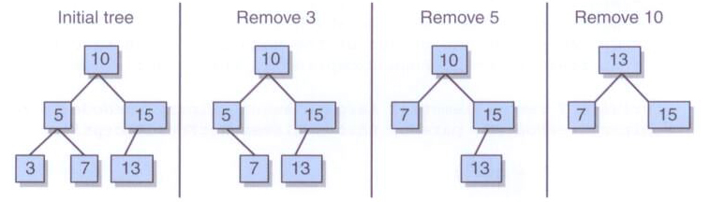
BST Element Removal

Slide 29
/**
* Removes elements that match the specified target element from
* the binary search tree. Throws a ElementNotFoundException if
* the sepcified target element is not found in this tree.
*
* @param targetElement the element being sought in the binary search tree
* @throws ElementNotFoundException if the target element is not found
*/
public void removeAllOccurrences(T targetElement)
throws ElementNotFoundException
{
removeElement(targetElement);
try
{
while (contains((T)targetElement))
removeElement(targetElement);
}
catch (Exception ElementNotFoundException)
{
}
}

Slide 30
/**
* Removes the node with the least value from the binary search
* tree and returns a reference to its element. Throws an
* EmptyCollectionException if this tree is empty.
*
* @return a reference to the node with the least value
* @throws EmptyCollectionException if the tree is empty
*/
public T removeMin() throws EmptyCollectionException
{
T result = null;
if (isEmpty())
throw new EmptyCollectionException("LinkedBinarySearchTree");
else
{
if (root.left == null)
{
result = root.element;
root = root.right;
}
else
{
BinaryTreeNode<T> parent = root;
BinaryTreeNode<T> current = root.left;

Slide 31
while (current.left != null)
{
parent = current;
current = current.left;
}
result = current.element;
parent.left = current.right;
}
modCount--;
}
return result;
}

Slide 32
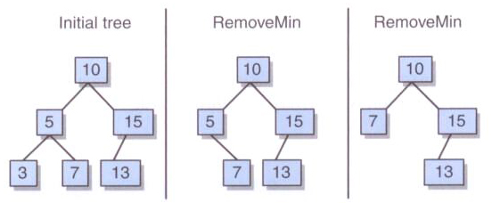
BST Element Removal
Removing the minimum element:

Slide 33
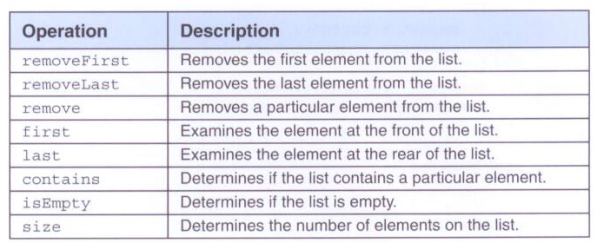

Using BSTs to Implement Ordered Lists
Recall the list operations:
And specifically for ordered lists:

Slide 34
package jsjf;
import jsjf.exceptions.*;
import java.util.Iterator;
/**
* BinarySearchTreeList represents an ordered list implemented using a binary
* search tree.
*
* @author Lewis and Chase
* @version 4.0
*/
public class BinarySearchTreeList<T> extends LinkedBinarySearchTree<T>
implements ListADT<T>, OrderedListADT<T>, Iterable<T>
{
/**
* Creates an empty BinarySearchTreeList.
*/
public BinarySearchTreeList()
{
super();
}
/**
* Adds the given element to this list.
*
* @param element the element to be added to the list
*/
public void add(T element)
{
addElement(element);
}

Slide 35
/**
* Removes and returns the first element from this list.
*
* @return the first element in the list
*/
public T removeFirst()
{
return removeMin();
}
/**
* Removes and returns the last element from this list.
*
* @return the last element from the list
*/
public T removeLast()
{
return removeMax();
}
/**
* Removes and returns the specified element from this list.
*
* @param element the element being sought in the list
* @return the element from the list that matches the target
*/
public T remove(T element)
{
return removeElement(element);
}

Slide 36
/**
* Returns a reference to the first element on this list.
*
* @return a reference to the first element in the list
*/
public T first()
{
return findMin();
}
/**
* Returns a reference to the last element on this list.
*
* @return a reference to the last element in the list
*/
public T last()
{
return findMax();
}
/**
* Returns an iterator for the list.
*
* @return an iterator over the elements in the list
*/
public Iterator<T> iterator()
{
return iteratorInOrder();
}
}

Slide 37
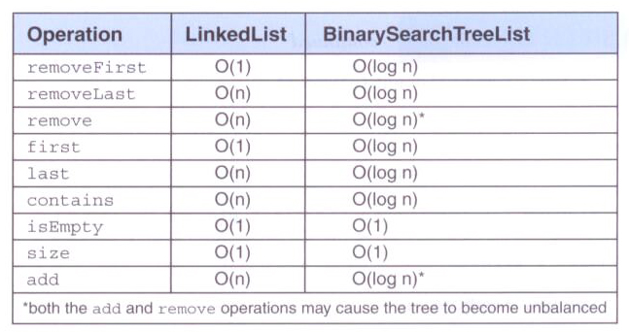
Ordered List Analysis
Comparing operations for both implementations of ordered lists:

Slide 38
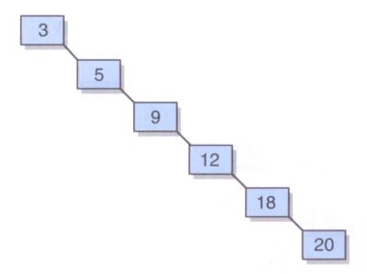
Balancing BSTs
As operations are performed on a BST, it could become highly unbalanced (a degenerate tree)

Slide 39
Balancing BSTs
Our implementation does not ensure the BST stays balanced
Other approaches do, such as AVL trees and red/black trees
We will explore rotations – operations on binary search trees to assist in the process of keeping a tree balanced
Rotations do not solve all problems created by unbalanced trees, but show the basic algorithmic processes that are used to manipulate trees

Slide 40
Balancing BSTs
A right rotation can be performed at any level of a tree, around the root of any subtree
Corrects an imbalance caused by a long path in the left subtree of the left child of the root
To correct the imbalance
make the left child element of the root the new root element
make the former root element the right child element of the new root
make the right child of what was the left child of the former root the new left child of the former root

Slide 41
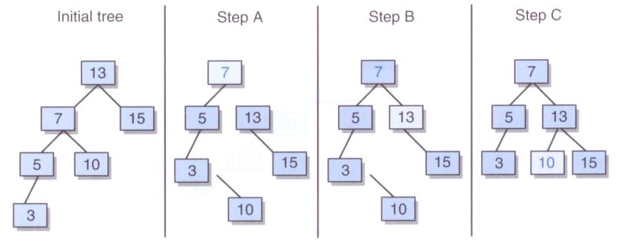
Balancing BSTs
A right rotation:

Slide 42
Balancing BSTs
A left rotation can be performed at any level of a tree, around the root of any subtree
Corrects an imbalance caused by a long path in the right subtree of the left child of the root
To correct the imbalance
make the right child element of the root the new root element
make the former root element the left child element of the new root
make the left child of what was the right child of the former root the new right child of the former root

Slide 43
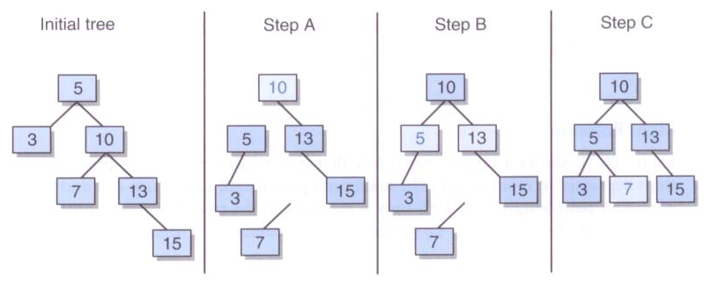
Balancing BSTs
A left rotation:

Slide 44
Balancing BSTs
If the imbalance is caused by a long path in the left subtree of the right child of the root we can address it by performing a rightleft rotation:
performing a right rotation around the offending subtree
and then performing a left rotation around the root

Slide 45
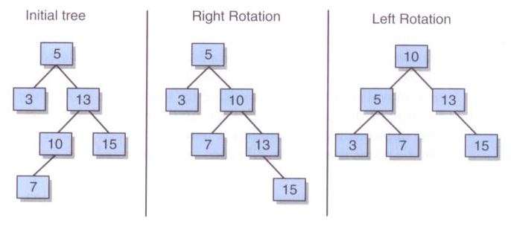
Balancing BSTs
A rightleft rotation:

Slide 46
Balancing BSTs
If the imbalance is caused by a long path in the right subtree of the left child of the root we can address it by performing a leftright rotation:
performing a left rotation around the offending subtree
and then performing a right rotation around the root

Slide 47
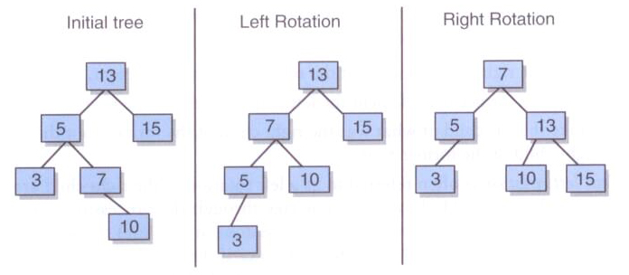
Balancing BSTs
A leftright rotation:

Slide 48
AVL Trees
An AVL tree (named after the creators) ensures a BST stays balanced
For each node in the tree, there is a numeric balance factor – the difference between the heights of its subtrees
After each add or removal, the balance factors are checked, and rotations performed as needed

Slide 49
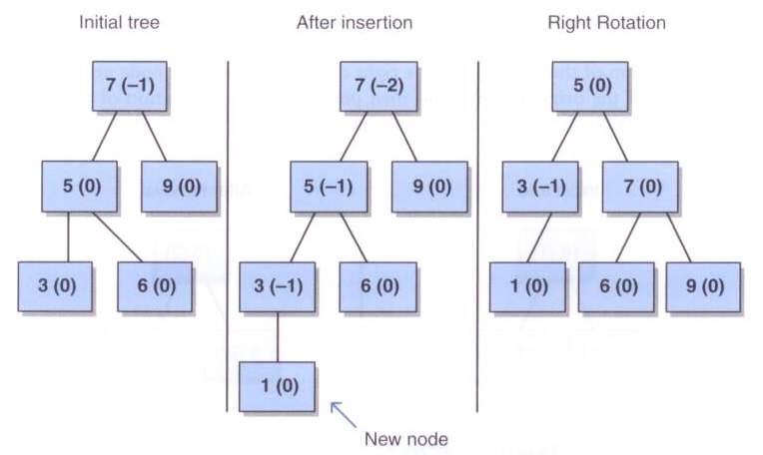
AVL Trees
A right rotation in an AVL tree:

Slide 50
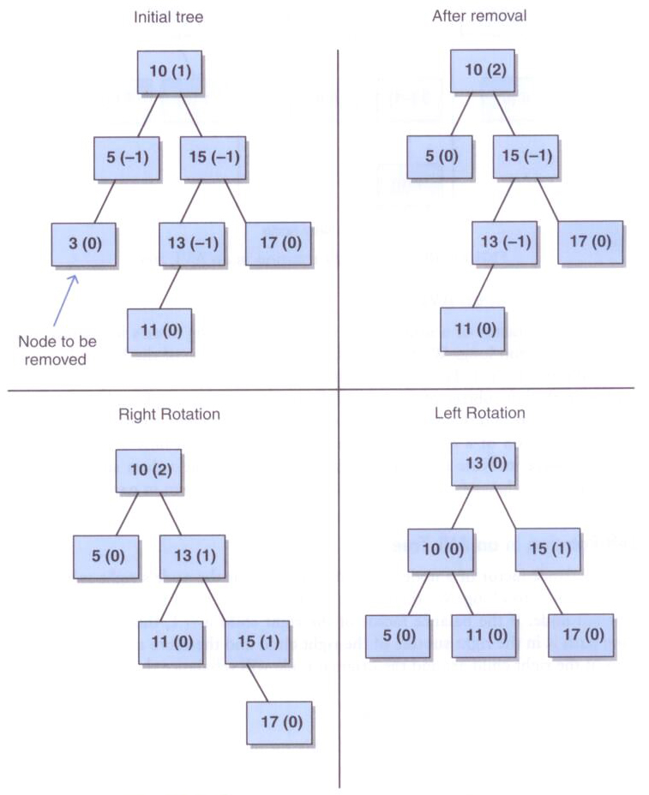
A rightleft rotation in an ALV tree:

Slide 51
Red/Black Trees
Another balanced BST approach is a red/black tree
Each node has a color, usually implemented as a boolean value
The following rules govern the color of a node:
the root is black
all children of red nodes are black
every path from the root to a leaf contains the same number of black nodes

Slide 52
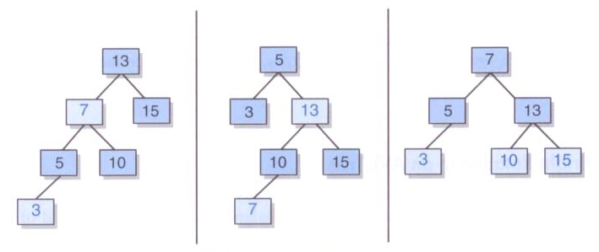
Red/Black Trees
Examples of red/black trees (light shading = red)

Slide 53
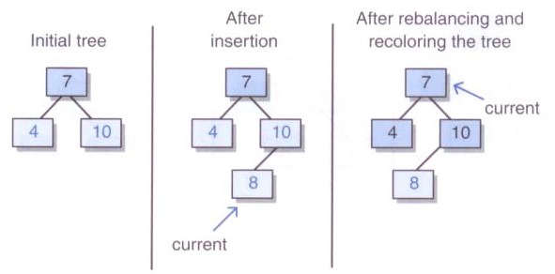
Red/Black Trees
A red/black tree after an insertion:

Slide 54
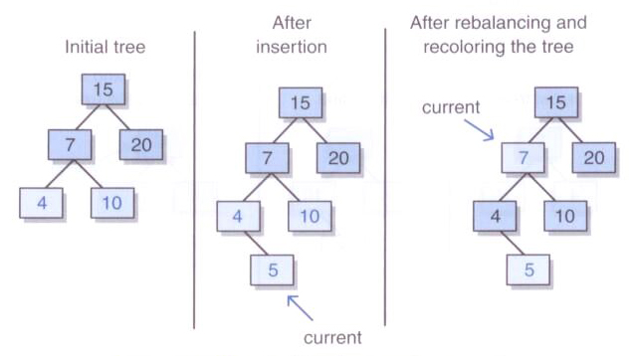
Red/Black Trees
A red/black tree after insertion:

Slide 55
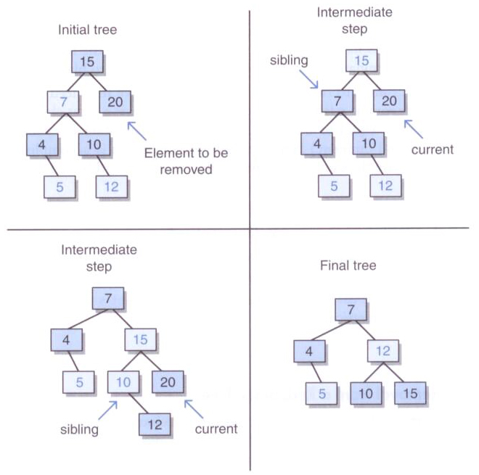
Red/Black Trees
A red/black tree removal:

